Slide 1
Technical Communication

Slide 2

Lead-in
What are the Four important channels through which information flows within the various sections of an organization?
Face-to-face communication
Communication over telephone
Communication through email
Communication through an inter-office memo
What is the efficient way to reach so many people at so many levels at once in an organization?
MEMO
Notes:
The larger the organization and the more levels of authority it has, the more inefficient phone calls and face-to-face discussions become.

Slide 3
Drafting Memos

Slide 4
1
Definition and Functions
2
Purposes of Memos
目 录
CONTENTS
3
Classification of memos
4
Elements in a memo
5
Useful Tips to Prepare Memos

Slide 5
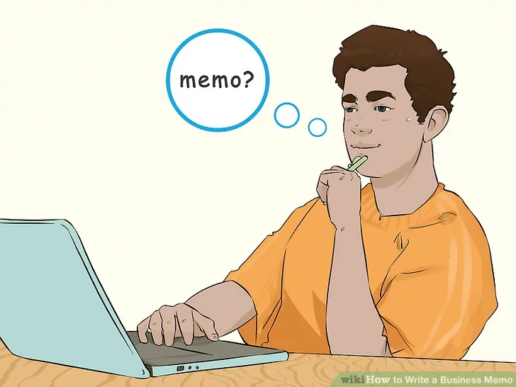
Definition of memo
shortened form of a Latin word “memorandum”
It must be remembered that …
a note of something to be remembered
a document frequently used in a company or an organization for internal communication to convey information and deal with business

Slide 6
Functions of memos
facilitate communication about various operations
help arrive at some quick decisions
help solve problems
by informing the reader about new information, such as policy changes, price increases
by persuading the reader to take an action, such as attend a meeting, use less paper, change a current production procedure
enable the information to flow in 3 types of organizational communication:
vertical (upward & downward), horizontal and diagonal
help bridge the communication gap among the various sections of an organization
serve as permanent record of information
informative
persuasive

Slide 7
Purposes of memos
To request for action or information
Compared with an oral request, a written request in the form of a memo is more difficult for the reader to forget or ignore
To explain to the reader something that is not understood.
To announce or to give formal notice to readers, publicly informing them about new procedures, new products, or anything that needs to be publicly known.
To confirm the details of a meeting, conversation, or telephone call.
To suggest solutions to business problems, to offer one’s services or those of the department, or to bring up new ideas or methods of doing things.
To report the details of a project at regular intervals as a way of helping the organization keep track of progress and problems.

Slide 8
Classification of memos
Documentary memos
mainly used for conveying information
Memos to a subordinate to remind, to announce, to give instructions, to explain a policy or procedure
Memos to a peer or superior to make a request or routine recommendation, or to confirm an agreement
Congratulatory memos
Used to give credit to employees of an organization for outstanding work they have accomplished
Disciplinary memos
issued to the employees who violate the rules or breach the code of conduct in an organization, for which they will be served with a severe warning or any other punishment as decided by the management
Notes:
A memo explaining the new method of maintaining medical records of employees in an organization
A memo requesting the head of another division to provide additional manpower for shifting some huge machines
A memo providing some suggestions for improving the existing billing system

Slide 9
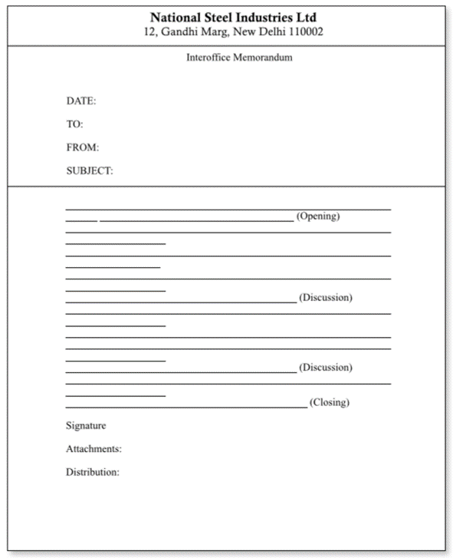

Name of the organization and address (printed)
Elements of a memo
Standard memos are divided into 5 main segments to organize information and to help achieve the writer’s purpose.
(complete and current date)
(designation to the recipient)
(designation of the sender)
1. Heading
(what the memo is about)
2. Opening
3. Discussion
memo
4. Closing
5. Signature
Optional

Slide 10
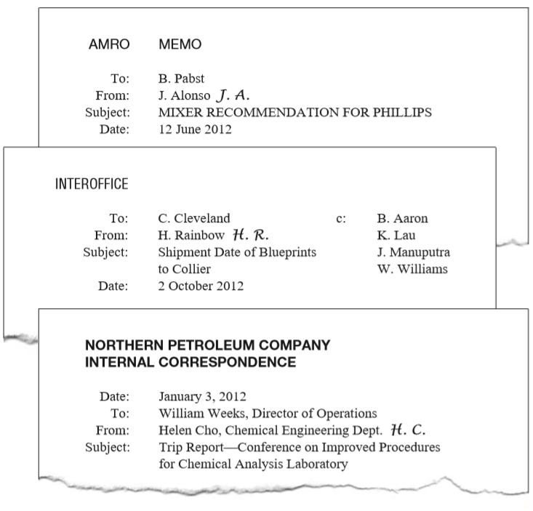
1. Heading
Some organizations prefer the full names of the writer and reader; others want only the first initials and last names.
Some prefer job titles; others do not.
Why do writers put their initials or signature next to the typed name?
To show that they have reviewed the memo and accept responsibility for it

Slide 11
The subject line, usu. typed in capitals, communicate to the reader(s) the purpose of the memo.
It should be specific but concise
One-word subject line gives a vague idea about the contents of the memo, but lacks focus.

Slide 12
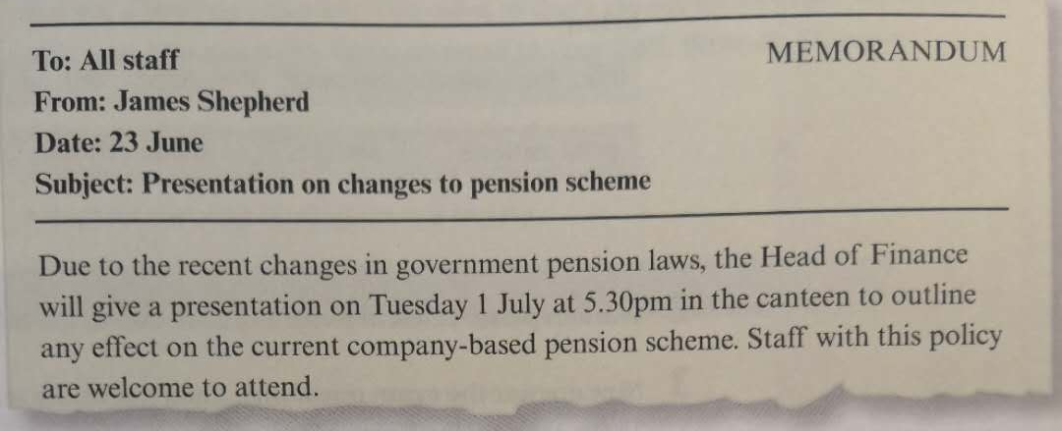
Subject Line
Study the Subject line of the memo below. The writer has taken the four key words from the main message. Underline those words in the body of the memo.

Slide 13
Read and Write
Read the following memos and write the subject line.
Subject: ________________
_______________________
As you are probably aware, the company is currently considering plans for a new factory in the district of Campi Bisenzio. Models and designs will be on display in the conference room every day next week. All staff are welcome to visit at any time and give feedback.
Display of new
Spanish classes
Subject: _________________
________________________
Please note that Spanish classes this year will begin on October 16th on Wednesday lunchtimes. Anyone wishing to participate should inform their line manager. Placement testing for new participants will take place in the training centre on Thursday 5th or Friday 6th between 12 and 1pm.
factory plans

Slide 14
Write out the month instead of using the all-numerical format.
In what order to list them?
in alphabetical order (from A to Z)
in descending order of organizational rank.

Slide 15
2. Opening
A memo should start with one or two clear sentences informing the reader of the need and purpose of the communication.
The purpose of a memo is presented in 3 parts:
the context and problem—the event, circumstance, or background of the problem being resolved or the topic handled in the memo
the specific assignment or task—the steps taken to help resolve the problem
the purpose—the reason for writing the memo and the prediction about what is in the rest of the memo

Slide 16
3. Discussion
develop the arguments that support our ideas
keep the communication brief since very few readers read every line of the memos they receive.
Begin with the information that is most important.
Follow the inverted pyramid pattern of communication. Start with the most general information and move to the specific or supporting facts.
Try to make the text more reader-friendly by applying boldface type, headings, columns, and graphics.
For easy reading, list the important points or details rather than writing in paragraphs when possible.
Be careful to make lists parallel in grammatical form.

Slide 17
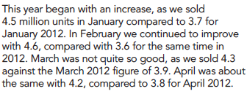
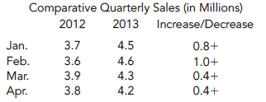
Example 1

Slide 18
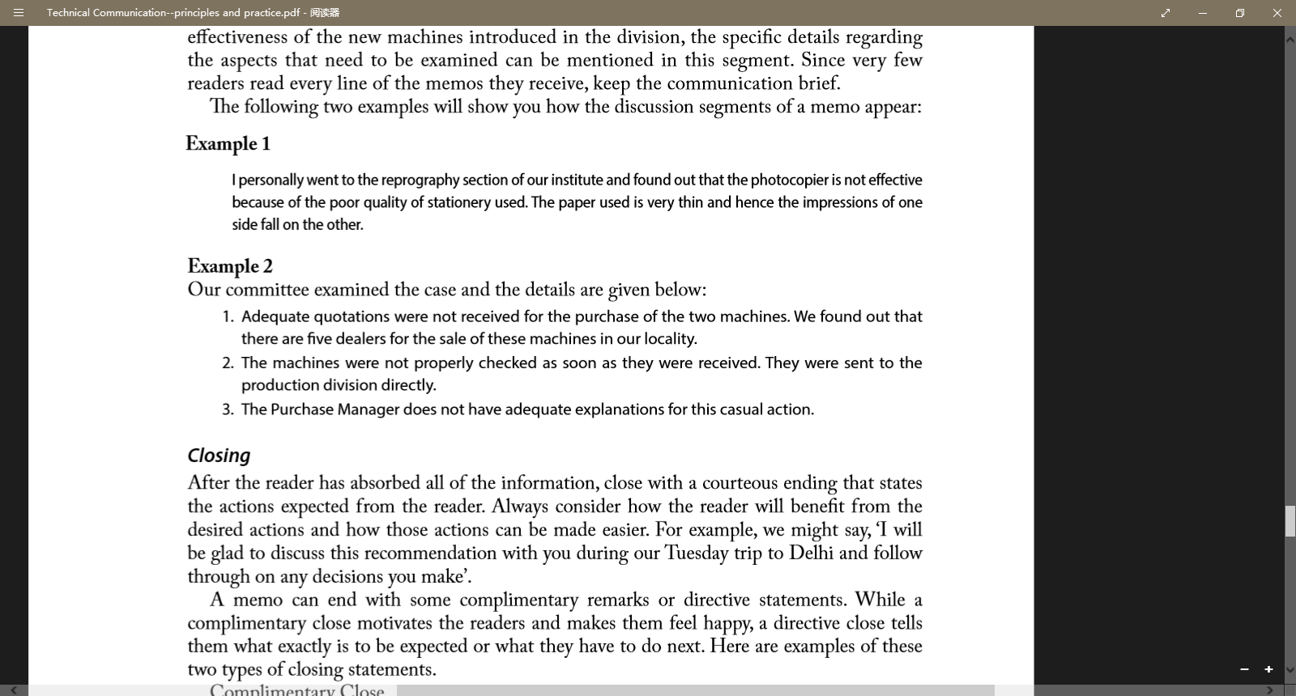
Example 2

Slide 19
4. Closing
close with a courteous ending that states the actions expected from the reader
always consider how the reader will benefit from the desired actions and how those actions can be made easier.
A memo can end with some complimentary remarks or directive statements.
motivates the readers and makes them feel happy
tells the readers what exactly is to be expected or what they have to do next

Slide 20
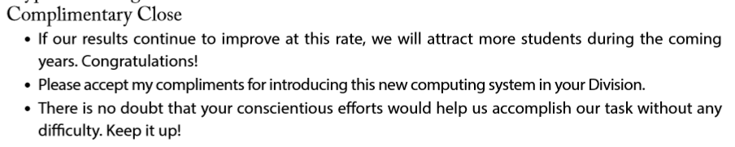
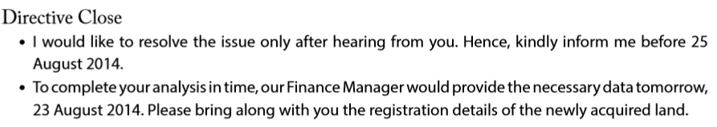
Example

Slide 21
Many memos end with one or more recommendations, which sometimes take the form of action steps: bulleted or numbered lists of what the writer will do, or what the writer would like others to do.
Action Items:
I would appreciate it if you would work on the following tasks and have your results ready for the meeting on Monday, June 9.
Henderson: recalculate the flow rate.
Smith: set up meeting with the regional EPA representative for sometime during the week of May 13.
Falvey: ask Armitra in Houston for his advice.

Slide 22
Two optional items
Necessary attachments
Distribution
Be sure to refer to the attachments in the memo
Add a notation about what is attached below the closing
To mention the designations of those people to whom a copy of the memo has been sent
To be replaced by Cc (courtesy copy or complimentary copy)
• Attached: Director’s approval letter
• Attached: Several Complaints about Product, January–June 2014
• Attached: List of absentees on 17 July 2014

Slide 23
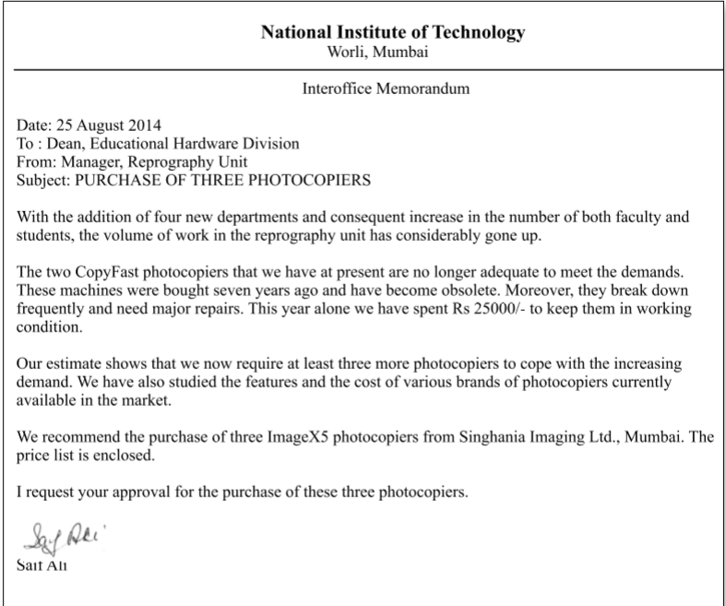
Sample memo 1
Read and analyze
Heading
background and problem
Reasons for the purchase
Request for the purchase
Recommendation for the purchase
Directive close
Signature
(written and printed)

Slide 24
What’s wrong with this memo?
Match the number in the memo with the mistakes on the right.
a. Not clear about the value of the webinar
b. Missing the year: 2015
c. Alignment incorrect
d. First letter of name not capitalized
e. Not clear about the purpose of the memo
f. Not clear about what action to take
g. Capital letters missing
h. Message not specific enough
INTEROFFICE Memo [1.]
T0: Frank
From: liam [2.]
Date: December 12 [3.]
Subject: New project [4.]
Cc: Louise [5.]
Jim Fox, the president of Lotus Communication, wrote me recently. He proposed that we create a webinar together. [6.]
Lotus Communication works with major universities around the world. It offers online learning programs aimed at non-native English speaking university graduates. Jim would like us to work together to offer a live webinar describing our new business writing course. [7.]
The details and content of the webinar are up to us. Let’s talk about it. [8.]
Suggested answers:
1. ( ) 2. ( ) 3. ( )
4. ( ) 5. ( ) 6. ( )
7. ( ) 8. ( )
g
d
b
h
c
e
a
f
Notes:
Image courtesy of Stuart Miles at FreeDigitalPhotos.net

Slide 25
Read and Revise
Date: October 14, 2012
To: CompuMed Employees
From: Jim Goodwin
Subject: Problems
As you know, we are experiencing some problems at CompuMed. These include lower profits and stock value declines. We have alot of unhappy stockholders. Its up to me to help everyone figure out how to solve our problems.
I have some ideas I want to share with you. I’m happy to have you share your ideas with me too. Here are my ideas: we need to consider consolidating departments and laying off some employees. We also might need to freeze wages and certainly its time to freeze travel.
The best idea I have is for some of you to take early retirement. If all of you who have over twenty years vested in the company would retire, that would save us around 2.1 million dollars over the next fiscal year. And, you know, saving money is good for all of us in the long run.

Slide 26
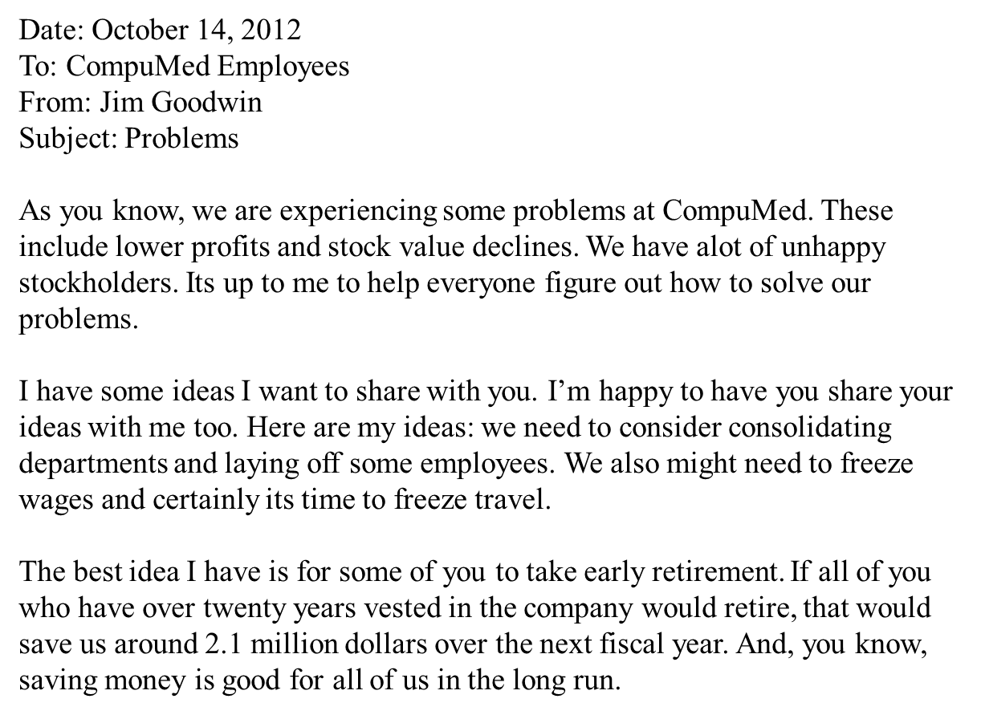
One-word subject lines do not communicate effectively.
There are spelling and grammatical errors.
The tone is not appropriate and unacceptable.
The suggested solutions to the problems are not specific and clearly presented.

Slide 27
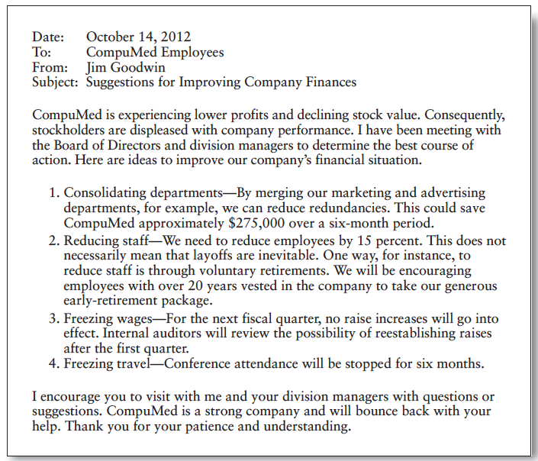
Revised version
MEMORANDUM
J G

Slide 28

Useful tips on writing memos
1. Use the standard format or the one prescribed by the organization.
2. Include all the necessary segments.
3. State clearly the context and purpose in the opening segment.
4. Keep in mind your relationship with the recipient to choose the degree of formality.
5. Maintain a positive or neutral tone.
6. State in the closing segment what action is expected from the recipient.
7. Use features like highlighting, bold face, etc. to draw attention.
8. Keep the memo short and to-the-point.

Slide 29

Questions for review
1. Does the identifying information adhere to your organization’s standards?
2. Did you include a specific subject line?
3. Did you clearly state your purpose at the start of the memo?
4. Did you include informative headings to help your readers?
5. If appropriate, did you summarize your message?
6. Did you provide appropriate background for the discussion?
7. Did you organize the discussion clearly?
8. Did you highlight items requiring action?

Slide 30
Exercise
Write a memo using a suitable format for the situation given below. Remember that your memo should be formal, clear, concise and contain only relevant information.
Your section moved to a new office on Thursday morning. However, the maintenance department within your organization has failed to carry out certain work. Word processors have not been wired to the laser printer; a metal bookshelf hasn’t been built properly; the bottom drawer of the filing cabinet which holds standard forms, was damaged in the move and now doesn’t open. Write a memo complaining about the situation and asking for action.

Slide 31
Key for reference
Memorandum
From: Section “B” Leader
To: The Maintenance Department
Date: 6th January 2011
Subject: Maintenance in our new office
As you know, our department moved into our new office on Thursday. Unfortunately, the previously agreed maintenance has not been completed. The following problems are outstanding:
1. Word processors require wiring to printers.
2. Metal bookshelf requires to be built.
3. Repair to filing cabinet drawer is needed.
I would be grateful to know when you will be able to complete the work.

Slide 32
Thank You for Attention！

